Slide 1
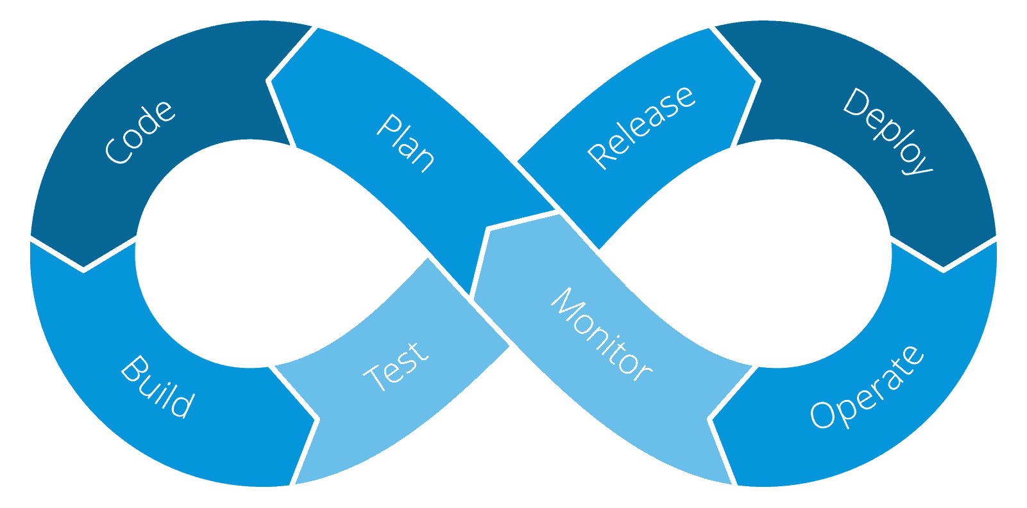




DevOps
Lessons from the Trenches
DEV
OPS
Gregory A. Beamer
https://www.linkedin.com/in/gregorybeamer/
@gbworld

Slide 2

?

Slide 3
Agenda
Ground Rules
What is DevOps?
What is DevOps Really?
Back to Basics
Planning the Pipeline
Wrap Up

Slide 4
Ground Rules
Architecture Based Talk

Slide 5
Agnostic
Process Not Tools
When A Tool Is Used It Is For An Example, not A Recommendation
Plan to Succeed
Dig Into Best Practices
No Favoritism

Slide 6
What Is DevOps?
Cutting through some of the Bull****!

Slide 7
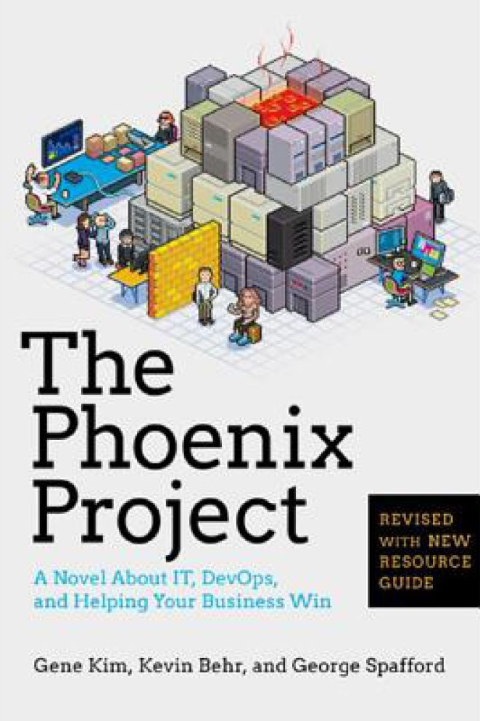
Starting Out
Company | Deployment Frequency
Amazon | 23,000 per day
Google | 5,500 per day
Netflix | 500 per day
Facebook | 1 per day
Twitter | 3 per week
Typical enterprise | 1 every 9 months
The Phoenix Project
Notes:
Many people’s first exposure to DevOps was through Phoenix Project, which is a theoretical fictional story

Slide 8
Dev + Ops = DevOps
DEV
QA
OPS
Development and Ops living in perfect harmony?
Notes:
The first view was dev + ops as one team
Then we add in QA

Slide 9
Cross Functional Team
Development
+ Testing
+ Operations
Notes:
If we think of a typical cross functional team, in Scrum we already think in terms of testing and development in one team (with PO and Scrummaster)
But DevOps says we start pulling Ops into the mix to fill in the rest

Slide 10
Dev + SEC + Ops = DevSecOps
DEV
SEC
OPS
Adding security as a Discipline
Notes:
The latest term is DevSecOps where we add security in

Slide 11
Cross Functional Team
Development
+ Testing
+ Operations
+ Security
Notes:
And this looks a bit like this – getting crowded in the bubble (team too large)

Slide 12
The CHallenge
PLAN
DEVELOP
RELEASE
OPERATE
?
?

Slide 13

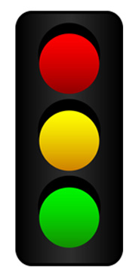



The CHALLENGE
Different purpose
Different Way to Track
Different Area of Focus
DEVELOP
DECIDE
DISPATCH
Notes:
Develop – forward momentum
Test – Decide on Acceptability
Sec/Ops – Dispatch or react to incidents

Slide 14



The CHALLENGE
Different purpose
Different Way to Track
Different Area of Focus
BUILD
INSPECT
RESPOND
DEVELOP
DECIDE
DISPATCH

Slide 15


The CHALLENGE
Different purpose
Different Way to Track
Different Area of Focus
PLANS
TICKETS
DEVELOP
DECIDE
DISPATCH

Slide 16
Cross Functional Team
Development
+ Testing
+ Operations
+ Security
Notes:
This is not conducive the the real world

Slide 17
What Is DevOps Really?
From Theory to Practice

Slide 18
Cross Functional Team
External DevOps
Coach
Development
+ Testing
+ Operations
+ Security
ADVISORS
CONSULTANTS
Notes:
This is not conducive the the real world

Slide 19
AUTOMATE Everything
Continuous Integration
Continuous Deployment
Continuous Delivery
Continuous Quality
Continuous Feedback
Automate to avoid Mistakes
Notes:
Have machines do the Repetitive Stuff

Slide 20

Why Automate?
Humans are Bad at Remembering Everything

Slide 21
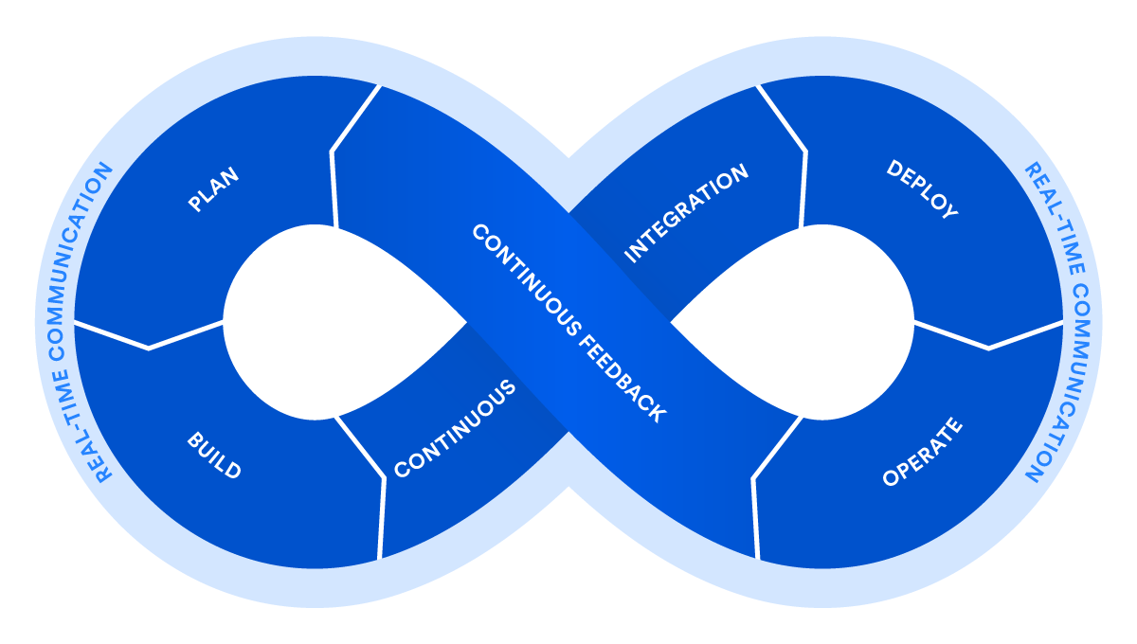
DEV
OPS

Slide 23










PLAN
BUILD & RELEASE
BUILD
RUN
þ
ý
Notes:
Everybody plans
Ops guy helps team build pipeline
Ops guys adds feedback cycles
And monitoring

Slide 24
Back to Basics
Foundations for DevOps

Slide 25
Back to Basics
The Big Picture
Organization
Agility
Discipline

Slide 26
The Big Picture
PLAN
BUILD
RUN
þ
ý

Slide 27
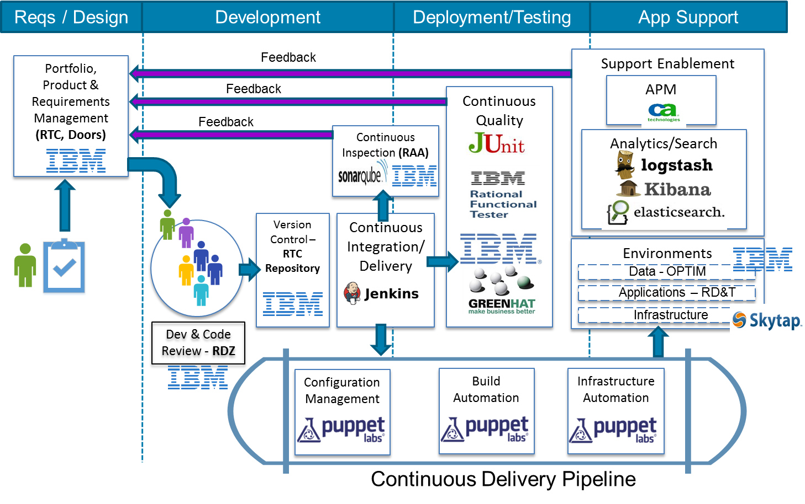
The Big Picture

Slide 28
Organization
Test Driven/
Test Early Approach
TDD
BDD
ATDD
Adapter-based
Boundaries
TESTS
ADAPTER
ADAPTER
Overview: The CASA Model
CORE
CONTRACT
CONTRACT
ADAPTER
ADAPTER
DOMAIN
Contract First Development
Domain Driven Design

Slide 29
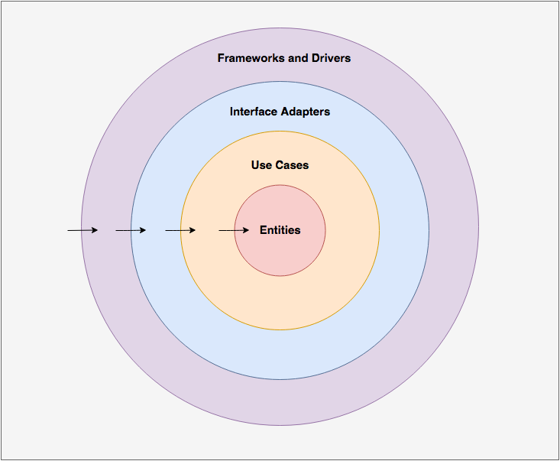
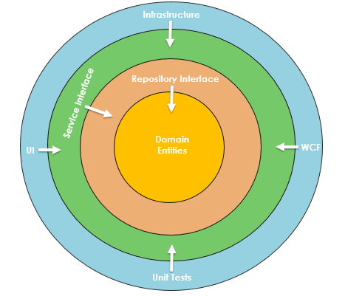
Organization
Overview: The CASA Model

Slide 30
Organization
Test Driven/
Test Early Approach
TDD
BDD
ATDD
Adapter-based
Boundaries
TESTS
ADAPTER
ADAPTER
Overview: The CASA Model
CORE
CONTRACT
CONTRACT
ADAPTER
ADAPTER
DOMAIN
Contract First Development
Domain Driven Design

Slide 31
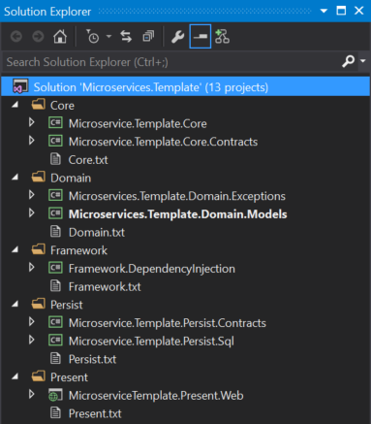
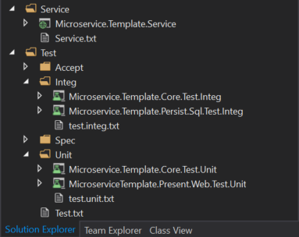
Organization

Slide 32
AGILITY
Make Teams Focus on Product Success
Ownership
Libraries
Once stable, remove from Solution
Make Into a Product
Package for Release
.NET == NuGet
Product Mindset

Slide 33
DISCIPLINE
Automate Everything You Can
Testing Is Aimed for Acceptability
User Acceptability, not Tech
Refactor is an Ongoing Discipline NOT a Problem Solving Move
Shift Left
Testing
Test Plans
TDD/BDD
Security Requirements

Slide 34
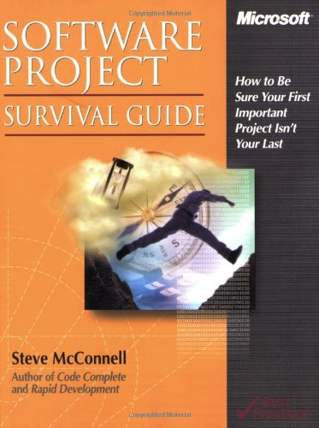
DISCIPLINE
Shift Left

Slide 35
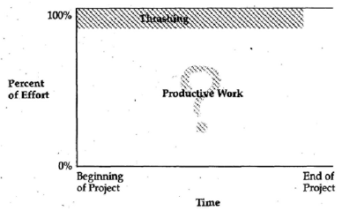
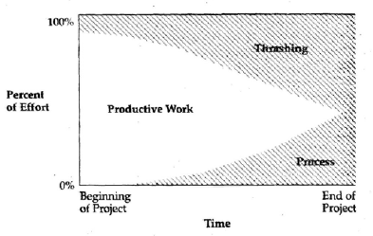
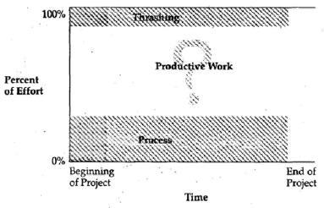
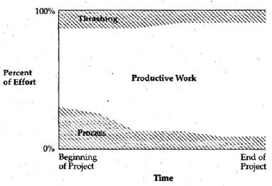
DISCIPLINE
Shift Left

Slide 36
DISCIPLINE
PLAN
BUILD
RUN
Shift Left
MONEY

Slide 37
Planning the Pipeline
Roadmap to Automation

Slide 38



The Pipeline
DEV
TEST
STAGE
PROD

Slide 39
DEV
TEST
STAGE
PROD
AUTO
AUTO
MANUAL

Slide 40
Planning
Configuration
Deployment Options
Getting ready

Slide 41


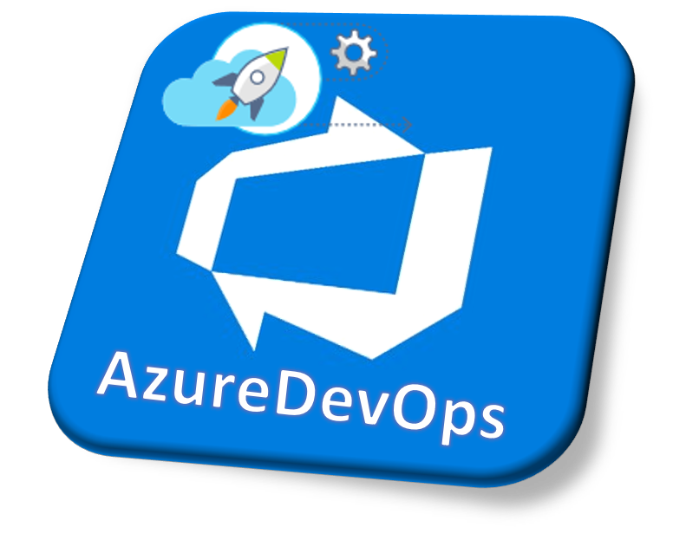





Planning
Part of Build
Part of Pipeline
Environment
Configuration

Slide 42
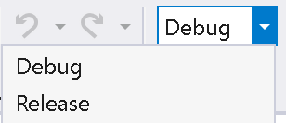
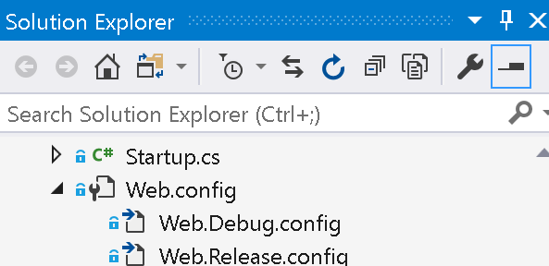
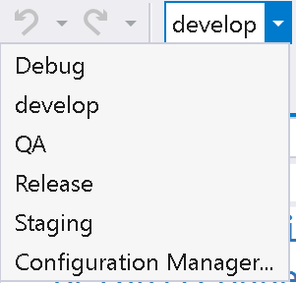
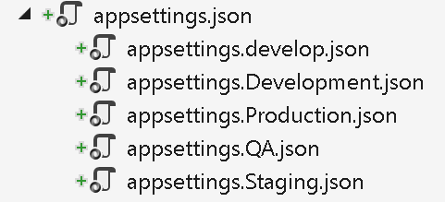
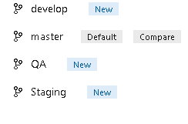
Planning
Part of Build
Configuration

Slide 43
Planning
Part of Build
þ
Dev
Configuration
þ
Test
Prod

Slide 44
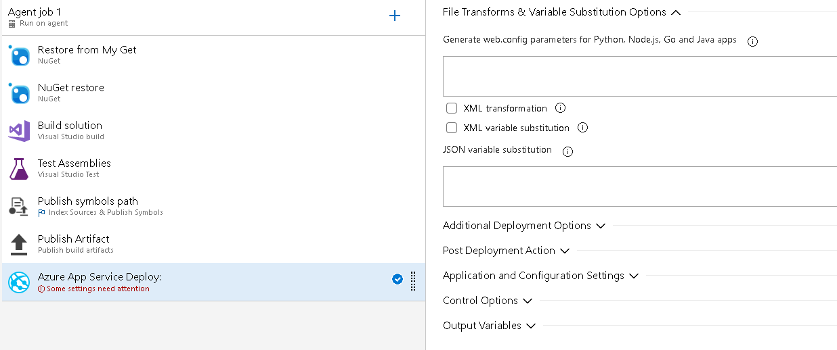
Planning
Part of Pipeline
Configuration

Slide 45
Planning
Part of Pipeline
þ
Master
Configuration
þ

Slide 46
Planning
Part of Pipeline
þ
Master
Configuration
ý

Slide 47
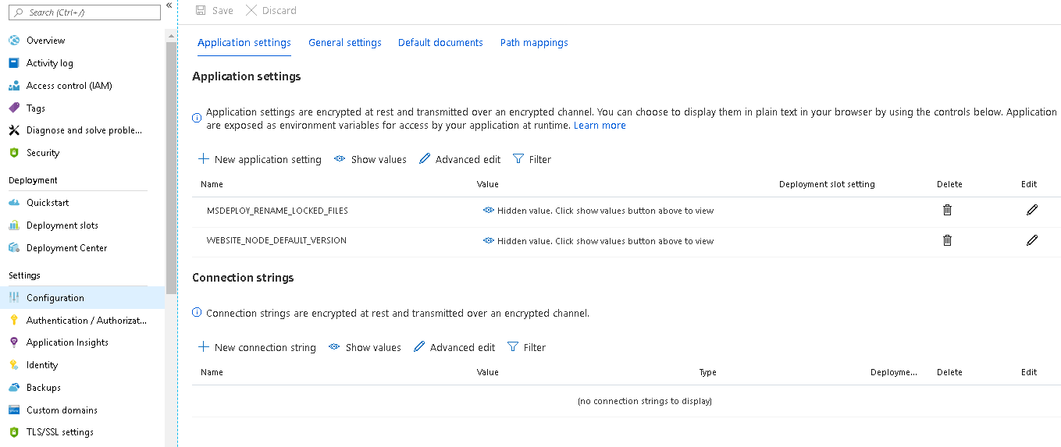
Planning
Environment
Configuration

Slide 48
Planning
Environment
þ
Master
Configuration
þ

Slide 49
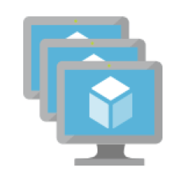
Planning
Deployment OPTIONS

Slide 50

Planning
Dev Machine
Develop
Test
Staging
Production
Deployment OPTIONS
Continuous Integration
Continuous Deployment
Continuous Delivery

Slide 51
Planning
Source Control
CI/CD
Automated Tests
Developer
Acceptance
End-To-END
Code Analysis
Static
Dynamic
Security (OWASP)
Monitoring
Orchestration
Configuration
Analytics
Database Automation
Infrastructure
As Code
“TerraForming”
Containers
Software

Slide 52
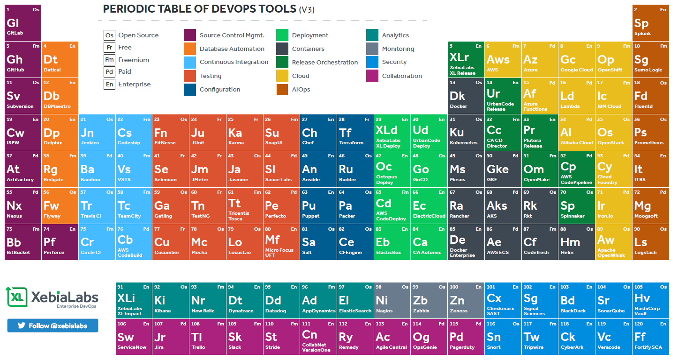
https://tinyurl.com/devopsperiodic

Slide 53
The Pipeline

Slide 54




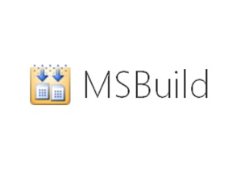



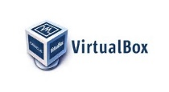




Planning the Pipeline

Slide 55
Planning the Pipeline
 |  | Local | Network
Area | Concern | Developer Machine | Dev | Test | Staging | Production
Develop | IDE
Develop | Tool(s)
Build | Technology
Build | Strategy
Provision | Hardware
Provision | Software
Deploy | Strategy
Deploy | Tool(s)
Deploy | Orchestration
Configure | Tool(s)
Quality/Test | Test: Unit
Quality/Test | Test: Integration
Quality/Test | Test: Acceptance
Quality/Test | Test: Performance
Quality/Test | Test: Load
Quality/Test | Code Analysis: Static
Quality/Test | Code Analysis: Security
Release | Tool(s)
Monitoring | Log Analysis
Monitoring | APM

Slide 56
DEMO

Slide 57
Wrapping Things Up
Take Aways

Slide 58
Agile Team
Product Mindset (Agile)
Productize stable projects/libraries
Automate the non-business problems
Environment Set up
Configuration
Deployment
Advisors/Consultants

Slide 59
The Pipeline
DEV
TEST
STAGE
PROD

Slide 60
DEV
TEST
STAGE
PROD
AUTO
AUTO
MANUAL

Slide 61
https://tinyurl.com/devopsperiodic

Slide 62
Explore
Pipeline
https://tinyurl.com/devessentials
Azure $200 credit (also Available at Azure.com) - Cloud
Azure DevOps (always free for 5 users) - Deploy
1 Month Pluralsight - Learn
https://tinyurl.com/jenkinsPipeline
Books
The Phoenix Project
The Checklist Manifesto
GitHub: https://github.com/gbworld

Slide 63
DevOps
Lessons from the Trenches
DEV
OPS
Gregory A. Beamer
https://www.linkedin.com/in/gregorybeamer/
@gbworld

